Slide 1
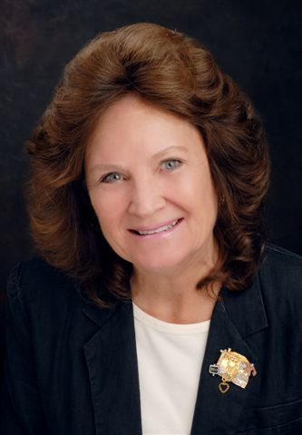
Southwest Section
Tax Compliance
Barbara Crooker
Mount Shasta

Slide 2
Tax Reminders for SWS chapters
Barbara Crooker flylady182@gmail.com
530-515-9729
The fiscal year ends May 31.
1. Balance your books.
2. Have your board do an informal audit for the year.
3. File your 990N with the IRS before Oct. 15.
4. Follow the instructions from HQ regarding business name and address. Those details are available in the members only section of the International web.
This is what all chapters need to do annually.

Slide 3
Tax Reminders for SWS chapters
Barbara Crooker flylady182@gmail.com
530-515-9729
California chapters need to file these additional forms.
1. FTB 199 for California
2. RRF-1 for California
3. Every two years chapters need to file the CA SOS statement of information. Usually, the request is received by mail. There is a small fee.

Slide 4
Tax Reminders for SWS chapters
Barbara Crooker flylady182@gmail.com
530-515-9729
I am monitoring chapters filing records as much as I can and will send reminders out as the Oct. deadline approaches.
Your will always need your EIN number for most forms and the corporate number for the California forms.
If you have any trouble, please contact me for help.

